Slide 1











Graph

Slide 2






Learning Outcomes
At the end of this session, a student will be able to
Understand Graph Data structure
Identify the appropriateness of graph data structure to real world applications
Understand and analyze a few algorithms on graphs including traversal, shortest-path and minimum spanning tree algorithms in Graphs

Slide 3












What is Graph?
A graph is a collection of entities connected using a set of interactions
Node/Vertex
Edges

Slide 4
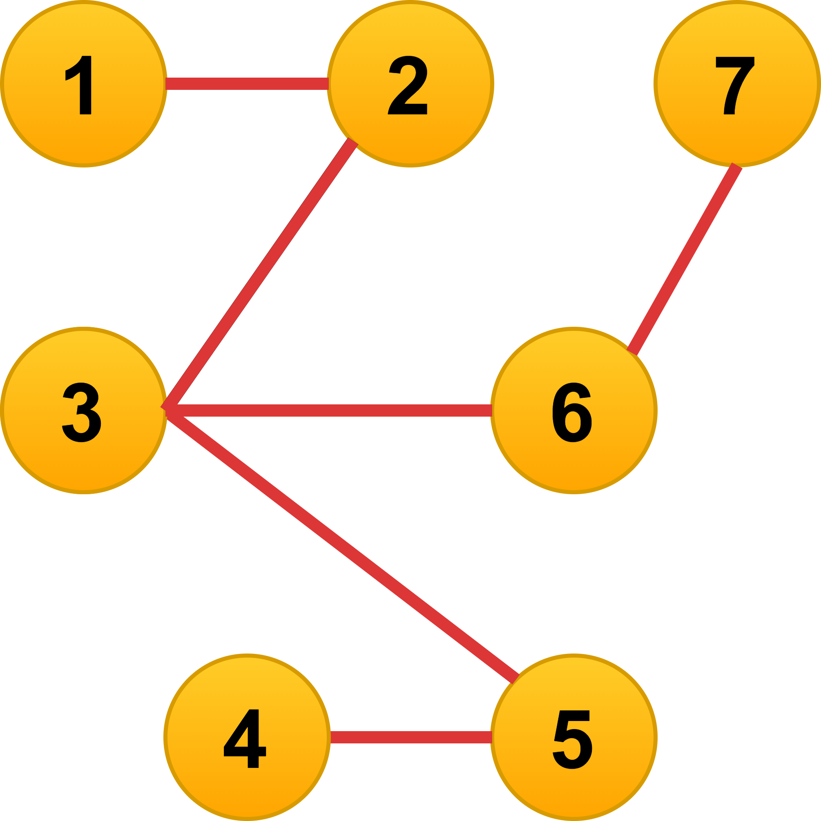























Definition
A Graph is represented by G=(V, E) where
V is set of vertices and
E is set of edges defined by E ⊆ V X V
7 vertices and 6 edges
V = {1,2,3,4,5,6,7}
E = {(1,2), (2,3), (3,5), (3,6), (4,5), (6,7)}

Slide 5


Why should graphs be studied??

Slide 6


graphs are everywhere!!
Any complex real-world system which has entities that interact can be modelled as a Graph.

Slide 7

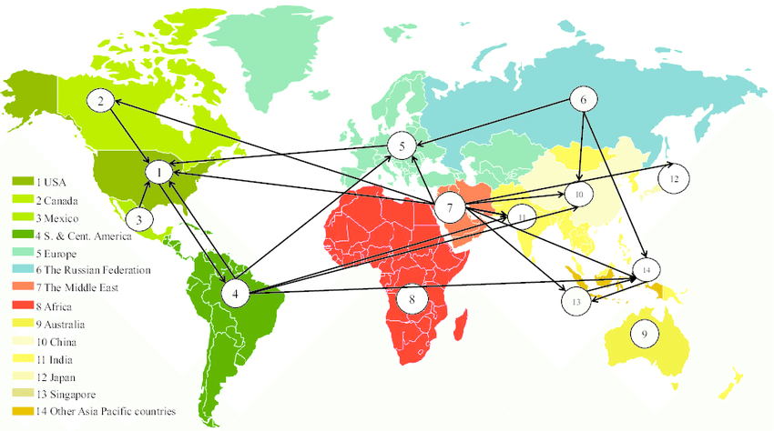
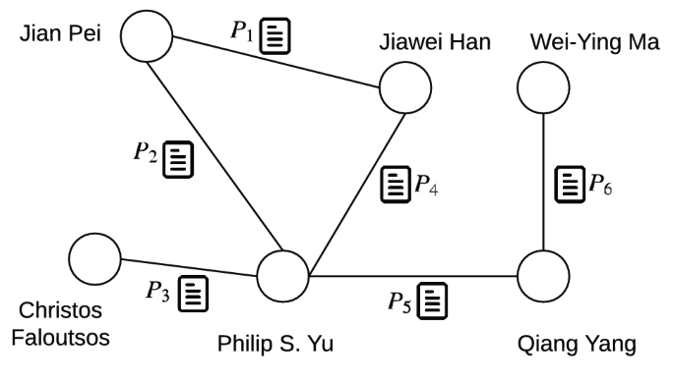
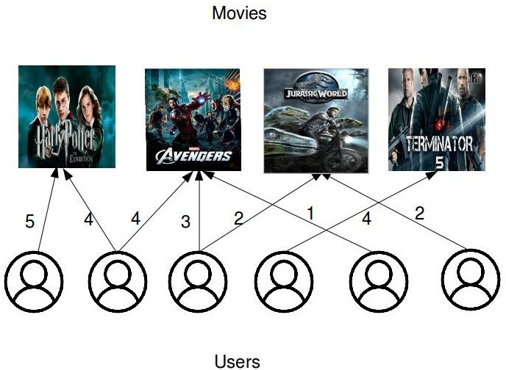



































Biological Graph
Trade Graph
Coauthorship Graph
Movie Rating Graph

Slide 8
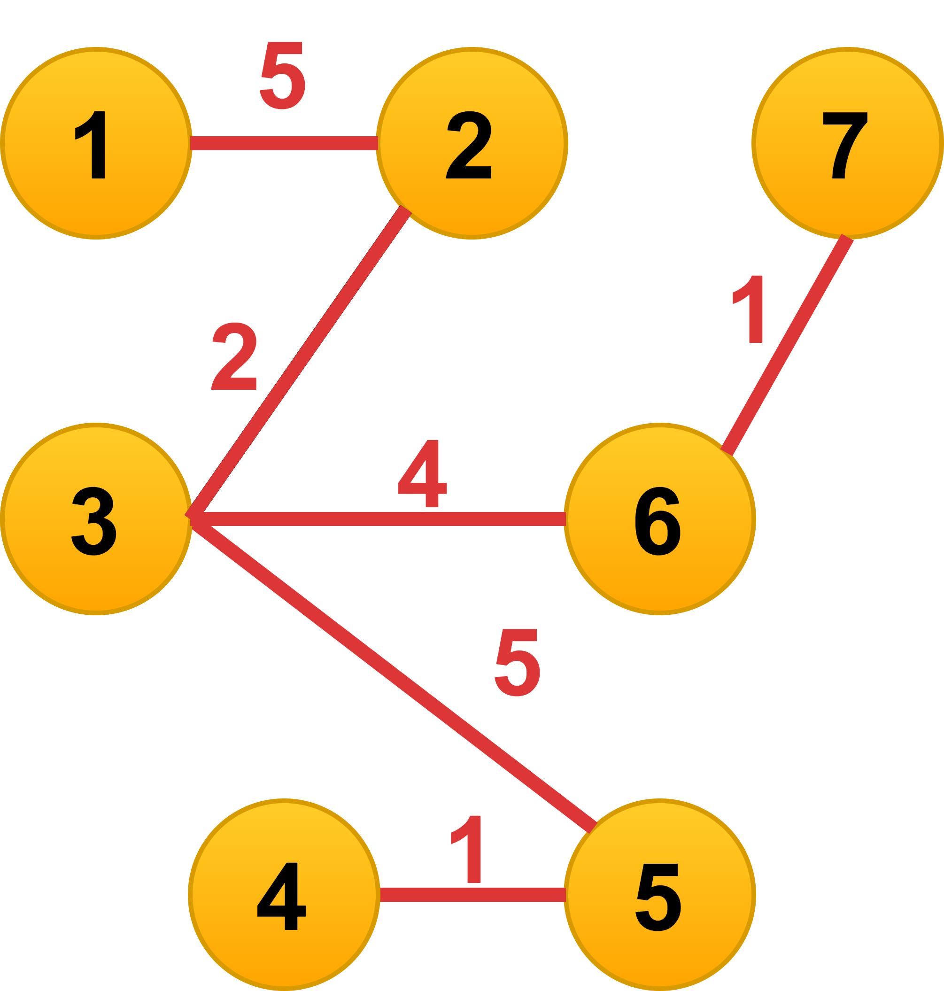
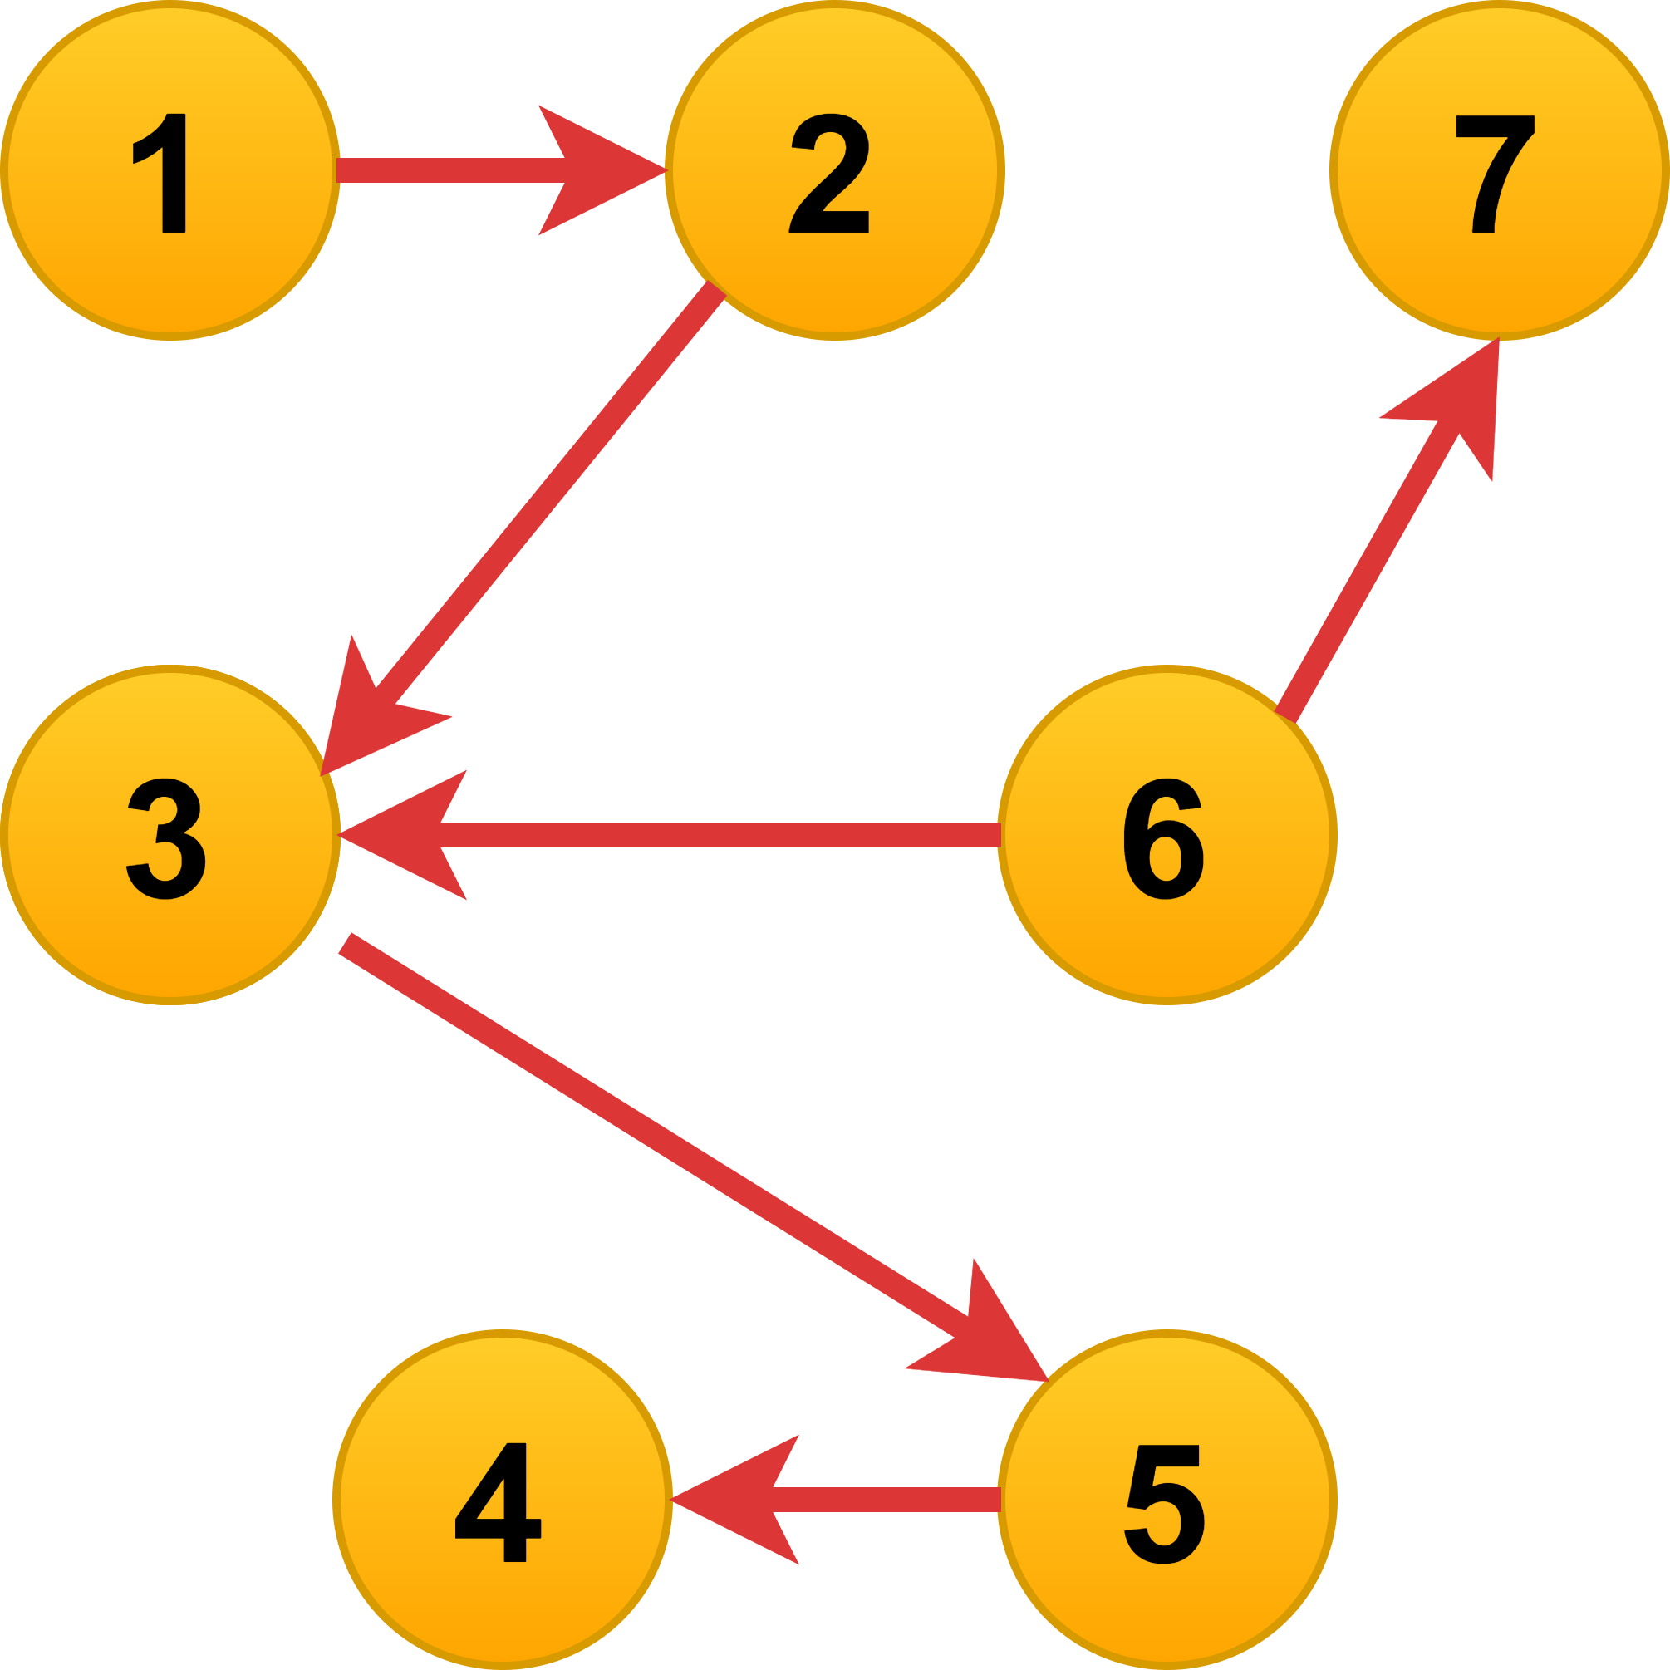













Types of graphs
Undirected Graph
Directed Graph
Weighted Graph
Example:
Friendship on facebook graph
Author Collaborations of
coauthorship graph
Example:
Follow on Twitter graph
Hyperlinks on World Wide Web
Example:
Movie Rating graph
Transportation graph

Slide 9





We would like to construct a graph, where the
nodes represent employees of a company
edges represent the number of times an employee sent an email to another employee.
What would be the best way to represent this information?
  Directed graph
  Undirected graph
  Weighted, directed graph
  Weighted, undirected graph
Answer: Weighted, directed graph
Since we want to capture who sent the email and who received it, we need a directed graph.
Since we also want to capture the number of times an employee emailed another, we want the edges to have weights

Slide 10
Representation in memory
Adjacency Matrix
Adjacency List

Slide 11
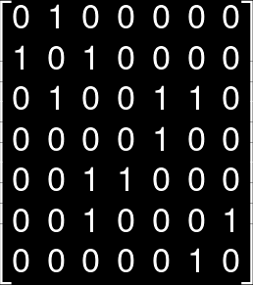









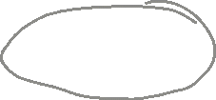













Adjacency Matrix: Undirected graph
A matrix of size n X n where n is the number of vertices in G.
$$A_{ij}=1 if there is an edge between nodes i and j$$
$$=0 otherwise$$
Observations
Matrix is symmetric
n² bits of space requirement.
Operations | Time Complexity
Check existence of an edge | O(1)
To find degree of a vertex | O(n)
To find neighbors of a vertex | O(n)
Principle diagonal

Slide 12







Adjacency List: Undirected graph
An array of Lists is used to store edges.
The size of array is equal to the number of vertices
Each array cell corresponds to a vertex.
i^{th} array entry points to a linked list containing the nodes that are adjacent to node i.
Array of Pointers
Linked list of adjacent nodes
1
2
3
4
5
6
7
2
Null
1
3
Null
2
5
6
Null
5
Null
3
4
Null
3
7
Null
6
Null

Slide 13

Adjacency List
Array of Pointers
Linked list of adjacent nodes
Space requirement: O(n+m)
1
2
3
4
5
6
7
2
Null
Operations | Time Complexity
Check existence of an edge | O(n)
To find degree of a vertex | O(n)
To find neighbors of a vertex | O(n)
1
3
Null
2
5
6
Null
5
Null
3
4
Null
3
7
Null
6
Null

Slide 14



graph algorithms
Traversal
Shortest path
Minimum spanning tree

Slide 15
graph algorithms
Traversal
Shortest path
Minimum spanning tree

Slide 16


Graph Traversal
Graph traversal refers to the process of visiting each vertex in a graph
Breadth First Traversal
(BFT)
Depth First Traversal
(DFT)

Slide 17







Breadth First Traversal
(BFT)

Slide 18
Breadth first traversal Algorithm
Data Structures
  Algorithm BFT(v) //v is starting vertex
  Step 1: Add v to the queue
  Step 2: visited[v]=True
  Step 3: while queue is not empty:
  v := deleteQ()
  for each neighbor i of v:
  if visited[i] is False:
  visited[i]=True
  addQ(i)
  end if
  end for
  end while
visited
  A Boolean array of size n.
  All entries are initialized to False.
  Use this to avoid re-visiting nodes
queue
  Stores nodes of graph to explore nodes level by level.
  addQ(x) : adds the element x to the queue
  deleteQ(): removes an element from queue
  Iinitially empty.
visited
F | F | F | F | F | F | F
1 | 2 | 3 | 4 | 5 | ... | n
Queue

Slide 19
Breadth-First-traversal - illustration
T
Visited
1 | 2 | 3 | 4 | 5 | 6 | 7
Queue
1
Current vertex:
Vertices visited:
1

Slide 20
Breadth-First-traversal - illustration
T
Visited
1 | 2 | 3 | 4 | 5 | 6 | 7
Queue
Current vertex: 1
Neighbors of 1: 2 Not visited
Vertices visited:
1

Slide 21
Breadth-First-traversal - illustration
T | T
Visited
1 | 2 | 3 | 4 | 5 | 6 | 7
Queue
2
Current vertex: 1
Neighbors of 1: 2 Not visited
Vertices visited:
1 | 2

Slide 22
Breadth-First-traversal - illustration
T | T
Visited
1 | 2 | 3 | 4 | 5 | 6 | 7
Queue
Current vertex: 2
Neighbors of 2: 1 visited
3 Not visited
Vertices visited:
1 | 2

Slide 23
Breadth-First-traversal - illustration
T | T | T
Visited
1 | 2 | 3 | 4 | 5 | 6 | 7
Queue
3
Current vertex: 2
Neighbors of 2: 1 visited
3 Not visited
Vertices visited:
1 | 2 | 3

Slide 24
Breadth-First-traversal - illustration
T | T | T
Visited
1 | 2 | 3 | 4 | 5 | 6 | 7
Queue
Current vertex: 3
Neighbors of 3: 2 visited
5 Not visited
6 Not visited
Vertices visited:
1 | 2 | 3

Slide 25
Breadth-First-traversal - illustration
T | T | T |  | T | T
Visited
1 | 2 | 3 | 4 | 5 | 6 | 7
Queue
5 | 6
Current vertex: 3
Neighbors of 2: 2 visited
5 Not visited
6 Not visited
Vertices visited:
1 | 2 | 3 | 5 | 6

Slide 26
Breadth-First-traversal - illustration
T | T | T |  | T | T
Visited
1 | 2 | 3 | 4 | 5 | 6 | 7
Queue
6
Current vertex: 5
Neighbors of 5: 3 visited
4 Not visited
Vertices visited:
1 | 2 | 3 | 5 | 6

Slide 27
Breadth-First-traversal - illustration
T | T | T | T | T | T
Visited
1 | 2 | 3 | 4 | 5 | 6 | 7
Queue
6 | 4
Current vertex: 5
Neighbors of 5: 3 visited
4 Not visited
Vertices visited:
1 | 2 | 3 | 5 | 6 | 4

Slide 28
Breadth-First-traversal - illustration
T | T | T | T | T | T
Visited
1 | 2 | 3 | 4 | 5 | 6 | 7
Queue
4
Current vertex: 6
Neighbors of 5: 3 visited
7 Not visited
Vertices visited:
1 | 2 | 3 | 5 | 6 | 4

Slide 29
Breadth-First-traversal - illustration
T | T | T | T | T | T | T
Visited
1 | 2 | 3 | 4 | 5 | 6 | 7
Queue
4 | 7
Current vertex: 6
Neighbors of 5: 3 visited
7 Not visited
Vertices visited:
1 | 2 | 3 | 5 | 6 | 4 | 7

Slide 30
Breadth-First-traversal - illustration
T | T | T | T | T | T | T
Visited
1 | 2 | 3 | 4 | 5 | 6 | 7
Queue
7
Current vertex: 4
Neighbors of 4: 5 visited
Vertices visited:
1 | 2 | 3 | 5 | 6 | 4 | 7

Slide 31
Breadth-First-traversal - illustration
T | T | T | T | T | T | T
Visited
1 | 2 | 3 | 4 | 5 | 6 | 7
Queue
Current vertex: 7
Neighbors of 7: 6 visited
Vertices visited:
1 | 2 | 3 | 5 | 6 | 4 | 7

Slide 32
Breadth-First-traversal - illustration
T | T | T | T | T | T | T
Visited
1 | 2 | 3 | 4 | 5 | 6 | 7
Queue
Current vertex:
Vertices visited:
1 | 2 | 3 | 5 | 6 | 4 | 7

Slide 33










Time Complexity of BFT
  Algorithm BFT(v):
  Step 1: Add v to the queue
  Step 2: visited[v]=True
  Step 3: while queue is not empty:
  v := deleteQ()
  for each neighbor i of v:
  if visited[i] is False:
  visited[i]=True.
  addQ(i)
Time Complexity : Adjacency Matrix
O(n²)
Time Complexity: Adjacency List
Scanning for all neighbours of a vertex takes O(m) time.
This needs to be done for all n vertices.
Hence The Time Complexity is O(m+n)

Slide 34
Applications of BFT
Shortest Path Finding: This is often used in navigation systems and network routing.
Search Engines: Crawlers build an index using Breadth First. The idea is to start from the source page and follow all links from the source and keep doing the same.
Social Networking Websites: Find people within a given distance ‘k’ from a person
Broadcasting in Network: A broadcasted packet follows Breadth First Search to reach all nodes.
Dependency Resolution: In software package management systems, BFS can be used to resolve dependencies. It ensures that all required packages are installed in the correct order without conflicts.

Slide 35
Depth First Traversal
(DFT)

Slide 36
depth first traversal Algorithm
  visited: A Boolean array of size n all entries are initialized to False
  Algorithm DFT(v):
  for each neighbor u of v do:
  if visited[u] ==false:
  visited[u]=true
  DFT(u)
Time Complexity
Adjacency Matrix: O(n²)
Adjacency List : O(m+n)

Slide 37
depth first traversal Illustration
Start with 1
Neighbors of 1 = {2}
Visit node 2
Neighbors of 2 = {1,3}
Node 1 is already visited
Therefore, visit node 3
Neighbors of 3 = {2,5,6}
Node 2 is already visited
Therefore, visit node 5
Neighbors of 5 = {3,4}
Node 3 is already visited.
Therefore, Visit node 4
Visit node 7
Neighbors of 7 = {6}
node 6 is already visited.
All nodes in the graph are visited.
Neighbors of 6 = {3,7}
Node 3 is already visited
Therefore, visit node 7
Neighbors of 4 = {5}
Node 5 is already visited and no more neighbors to visit.
Therefore, backtrack to neighbors of 5 and then to node 3.
Visit unvisited neighbor of 3, that is node 6.

Slide 38
graph algorithms
Traversal
Shortest path
Minimum spanning tree

Slide 39
shortest path
Single source shortest path
Dijkstra’s Algorithm
All source shortest path
Floyd-Warshal Algorithm

Slide 40
Single source shortest path
Dijkstra’s Algorithm

Slide 41
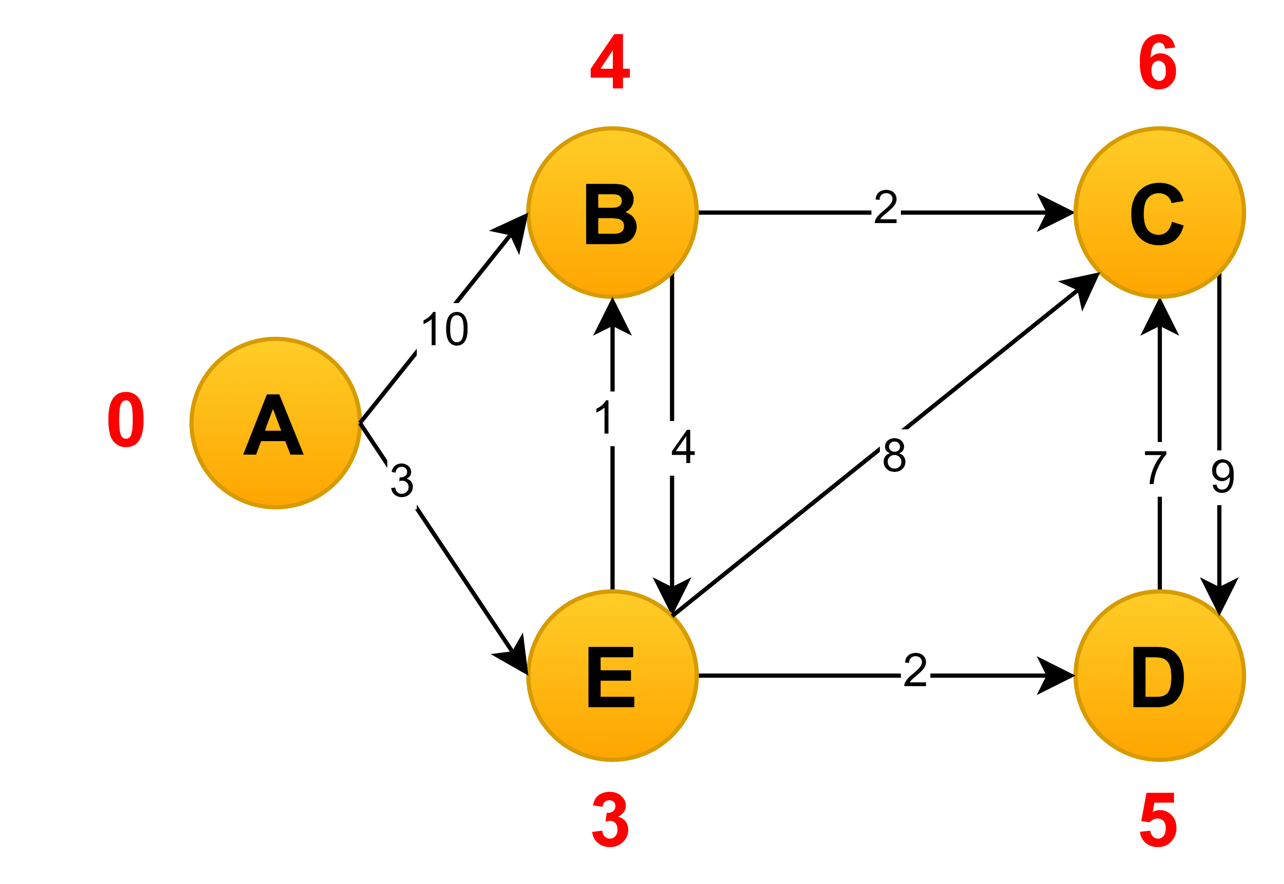
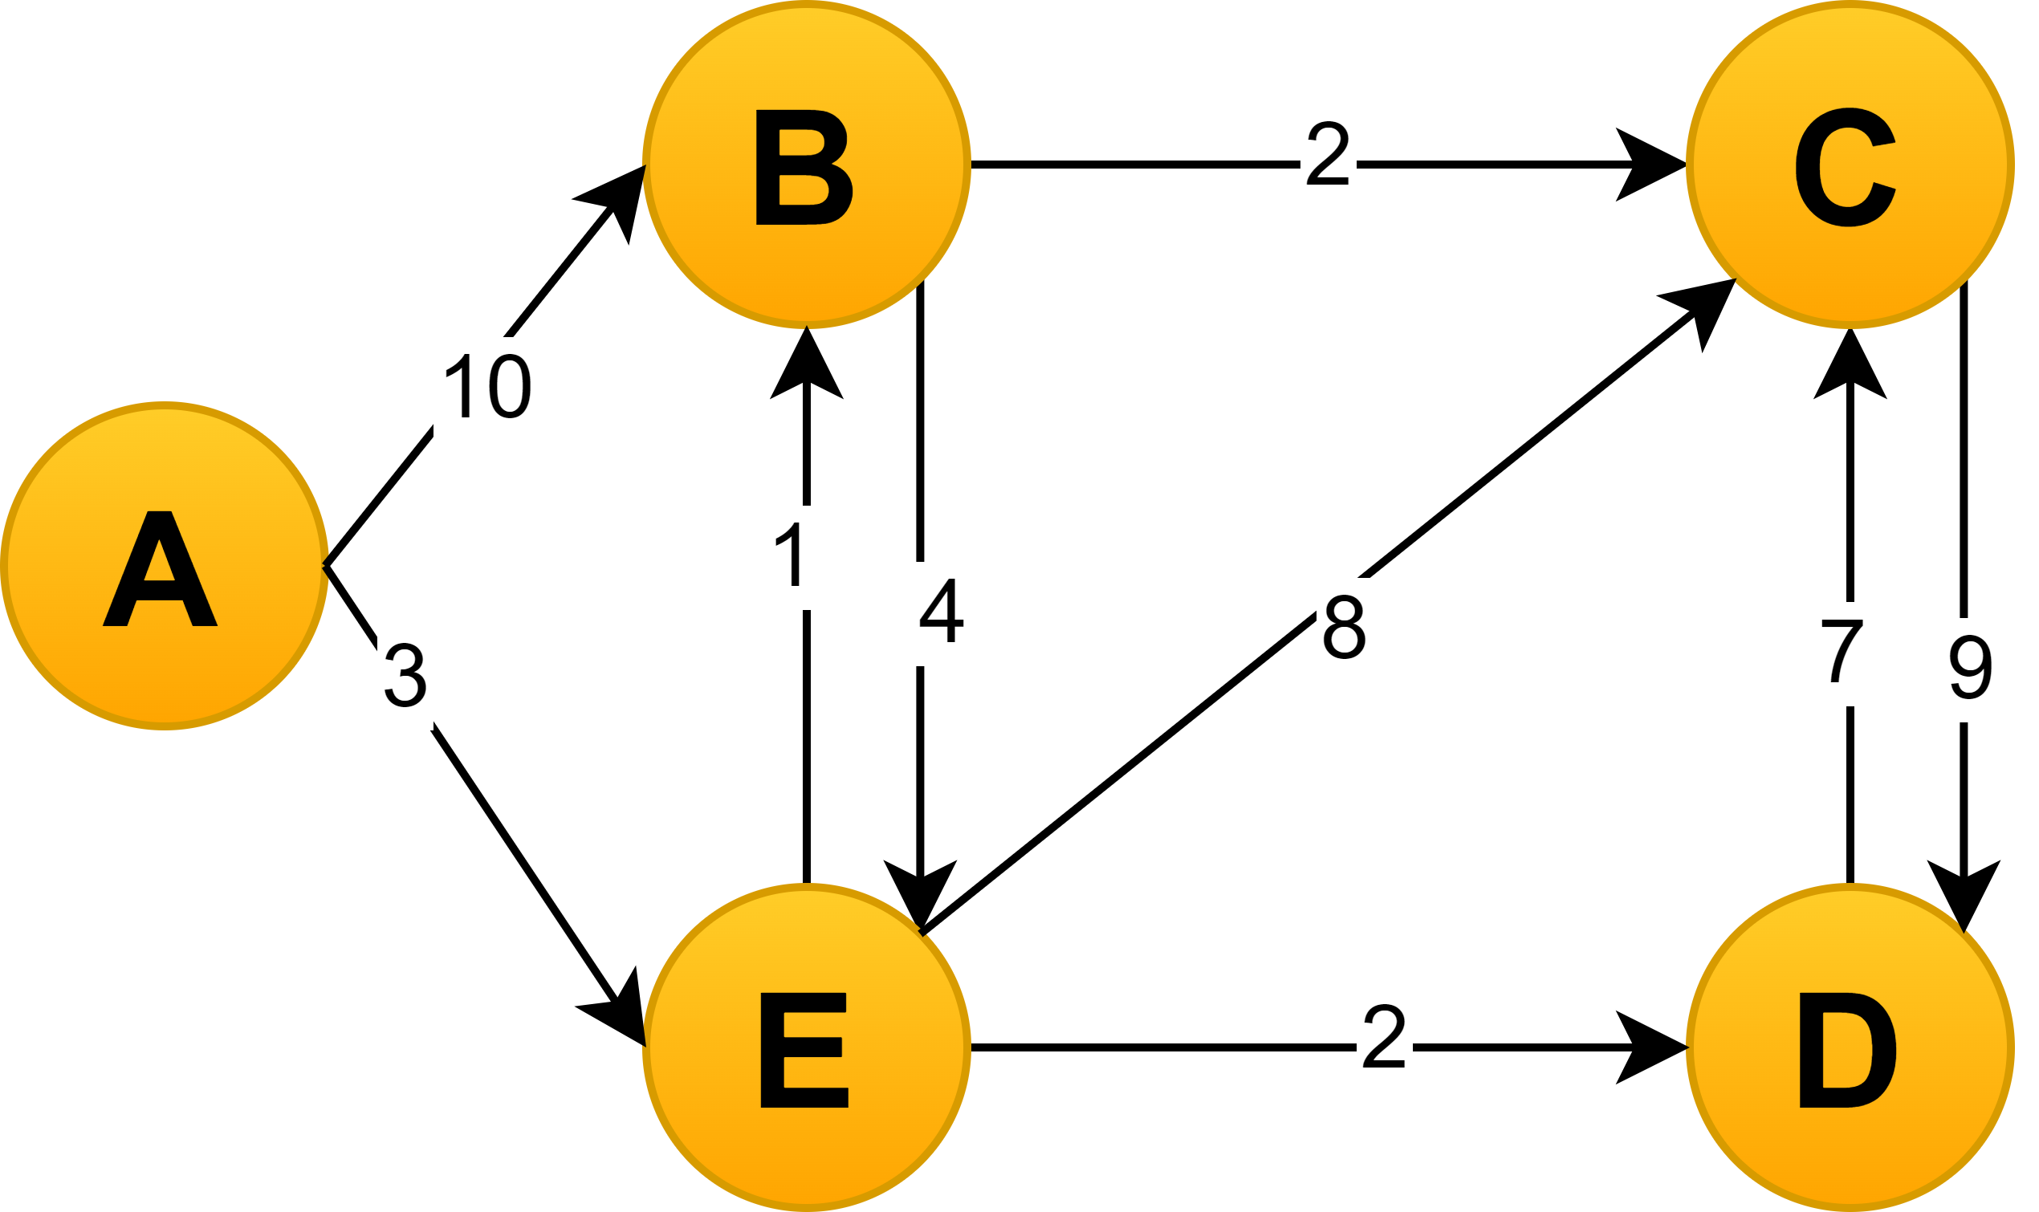
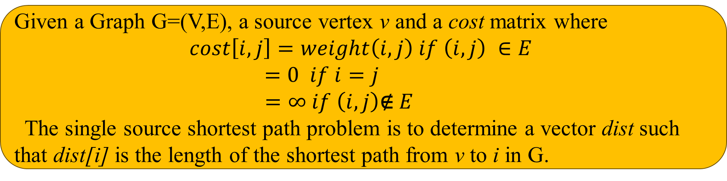
Problem description
Given a Graph G=(V,E), a source vertex v and a cost matrix where
$$cost\left[i,j\right]=weight\left(i,j\right) if \left(i,j\right) ∈E$$
$$=0 if i=j$$
$$=∞ if \left(i,j\right)\text{∉} E$$
The single source shortest path problem is to determine a vector dist such that dist[i] is the length of the shortest path from v to i in G.
Output: Distance Vector from node A
Input Graph
A | B | C | D | E
dist =
0 | 4 | 6 | 5 | 3

Slide 42
Algorithm: Dijkstra
Algorithm Dijkstra(G, cost, v)
for i = 0 to n-1 do
visited[i]=False; dist[i]=cost[v,i]
visited[v]=True; dist[v]=0
for i = 1 to n-1 do
Choose u from vertices not visited such that
dist[u] is minimum.
visited[u]=True
for each w adjacent to u which is unvisited
if (dist[u] + cost[u,w] < dist[w]) then
dist[w] = dist[u] + cost[u,w]
end if
end for
end for
return dist
Input
  Graph G =(V,E)
  cost matrix
  source vertex v.
Output: A vector dist of size n where dist[i]=shortest path distance of i from v.
Algorithm uses a vector visited to keep rack of all visited nodes.
dist
0 | 1 | 2 | ... |  | ... | n-1
visited
F | F | F | F | F | F | F
0 | 1 | 2 | ... |  | ... | n-1

Slide 43
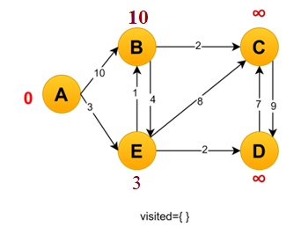
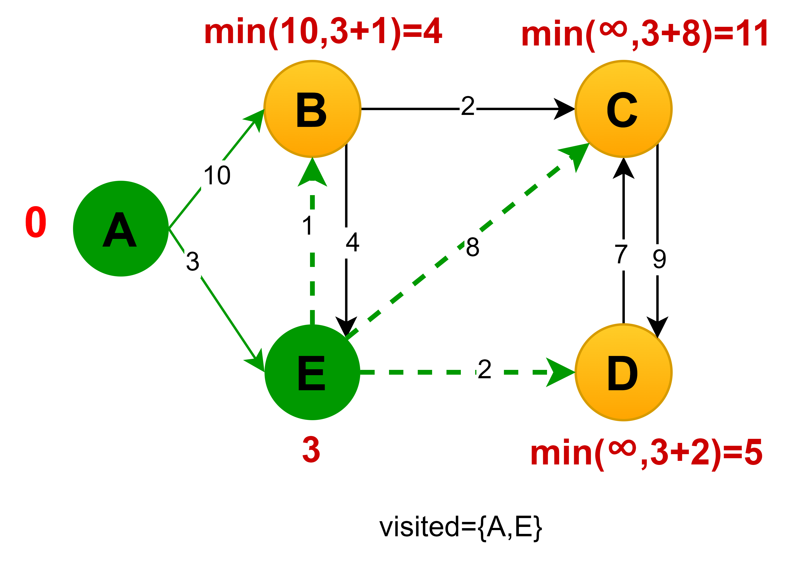
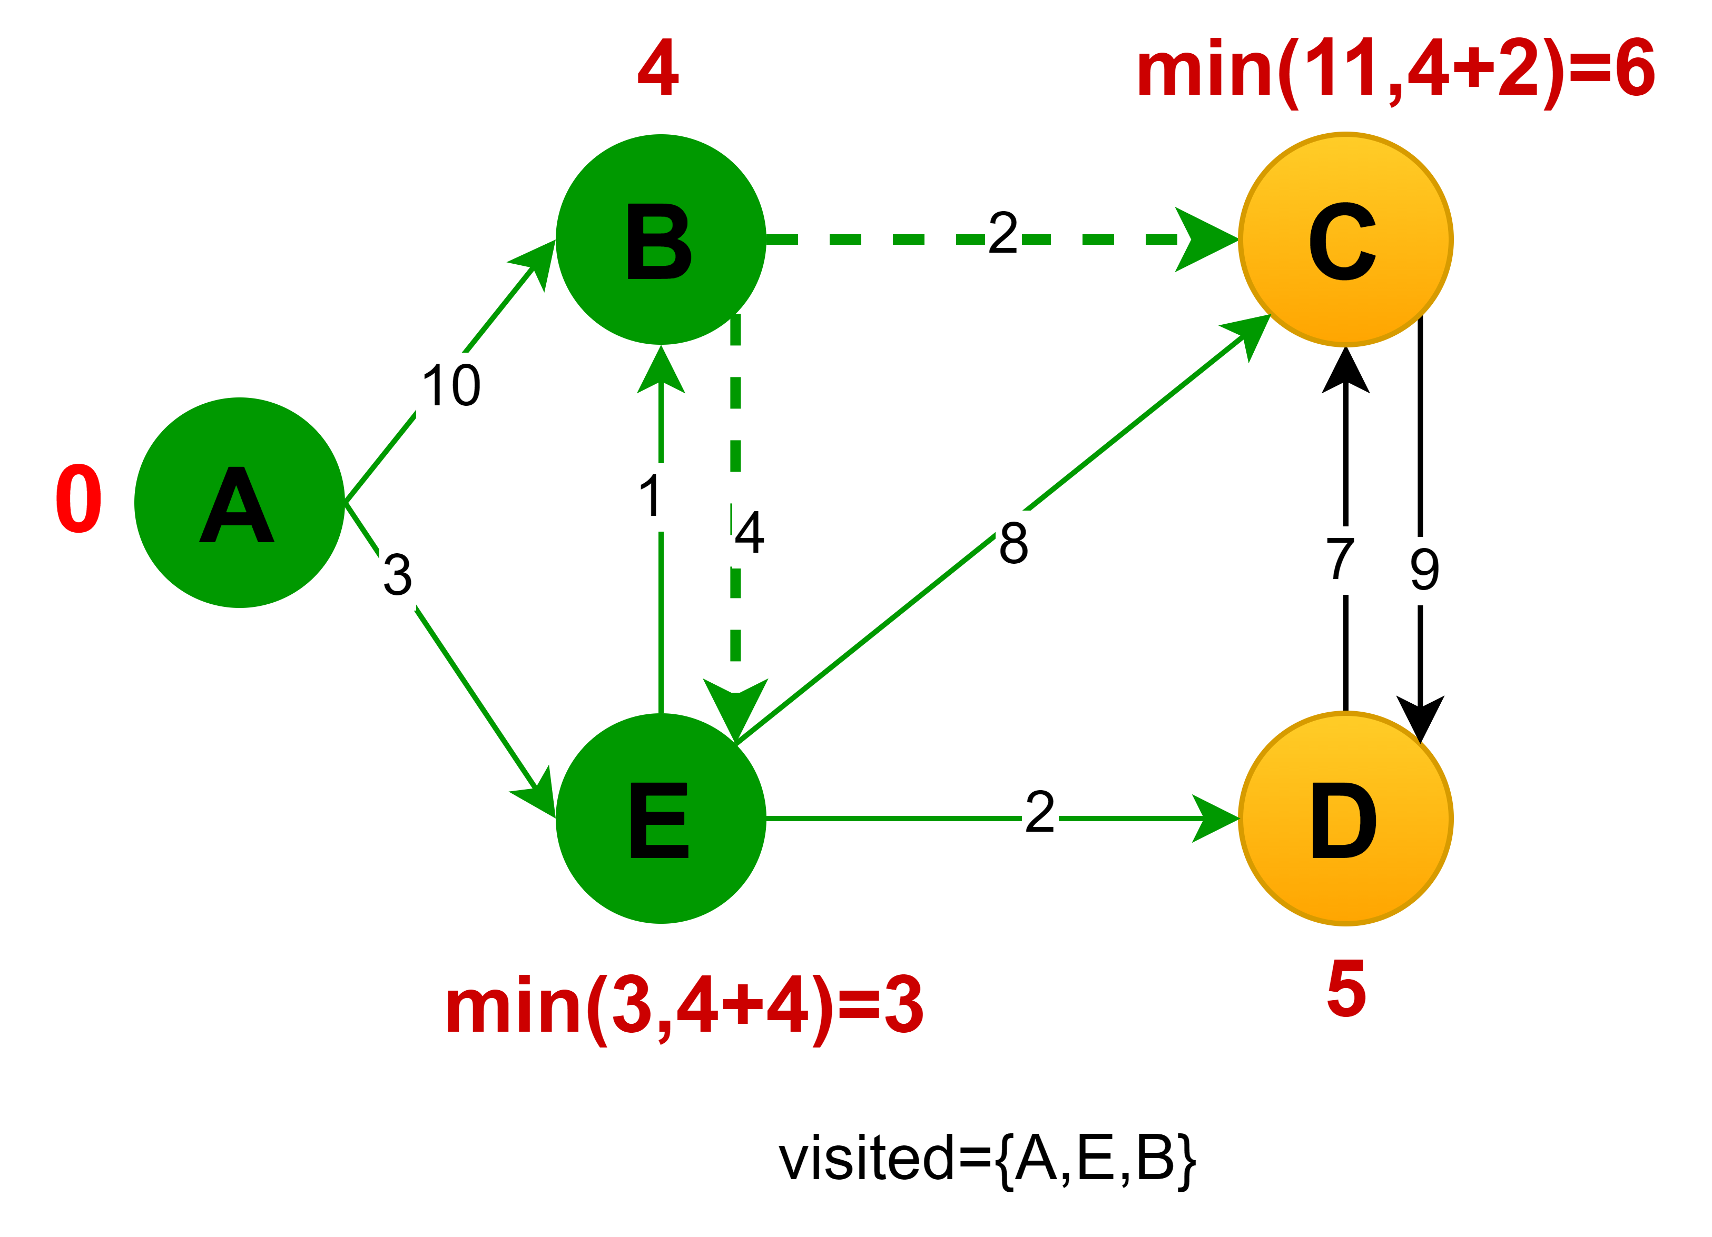
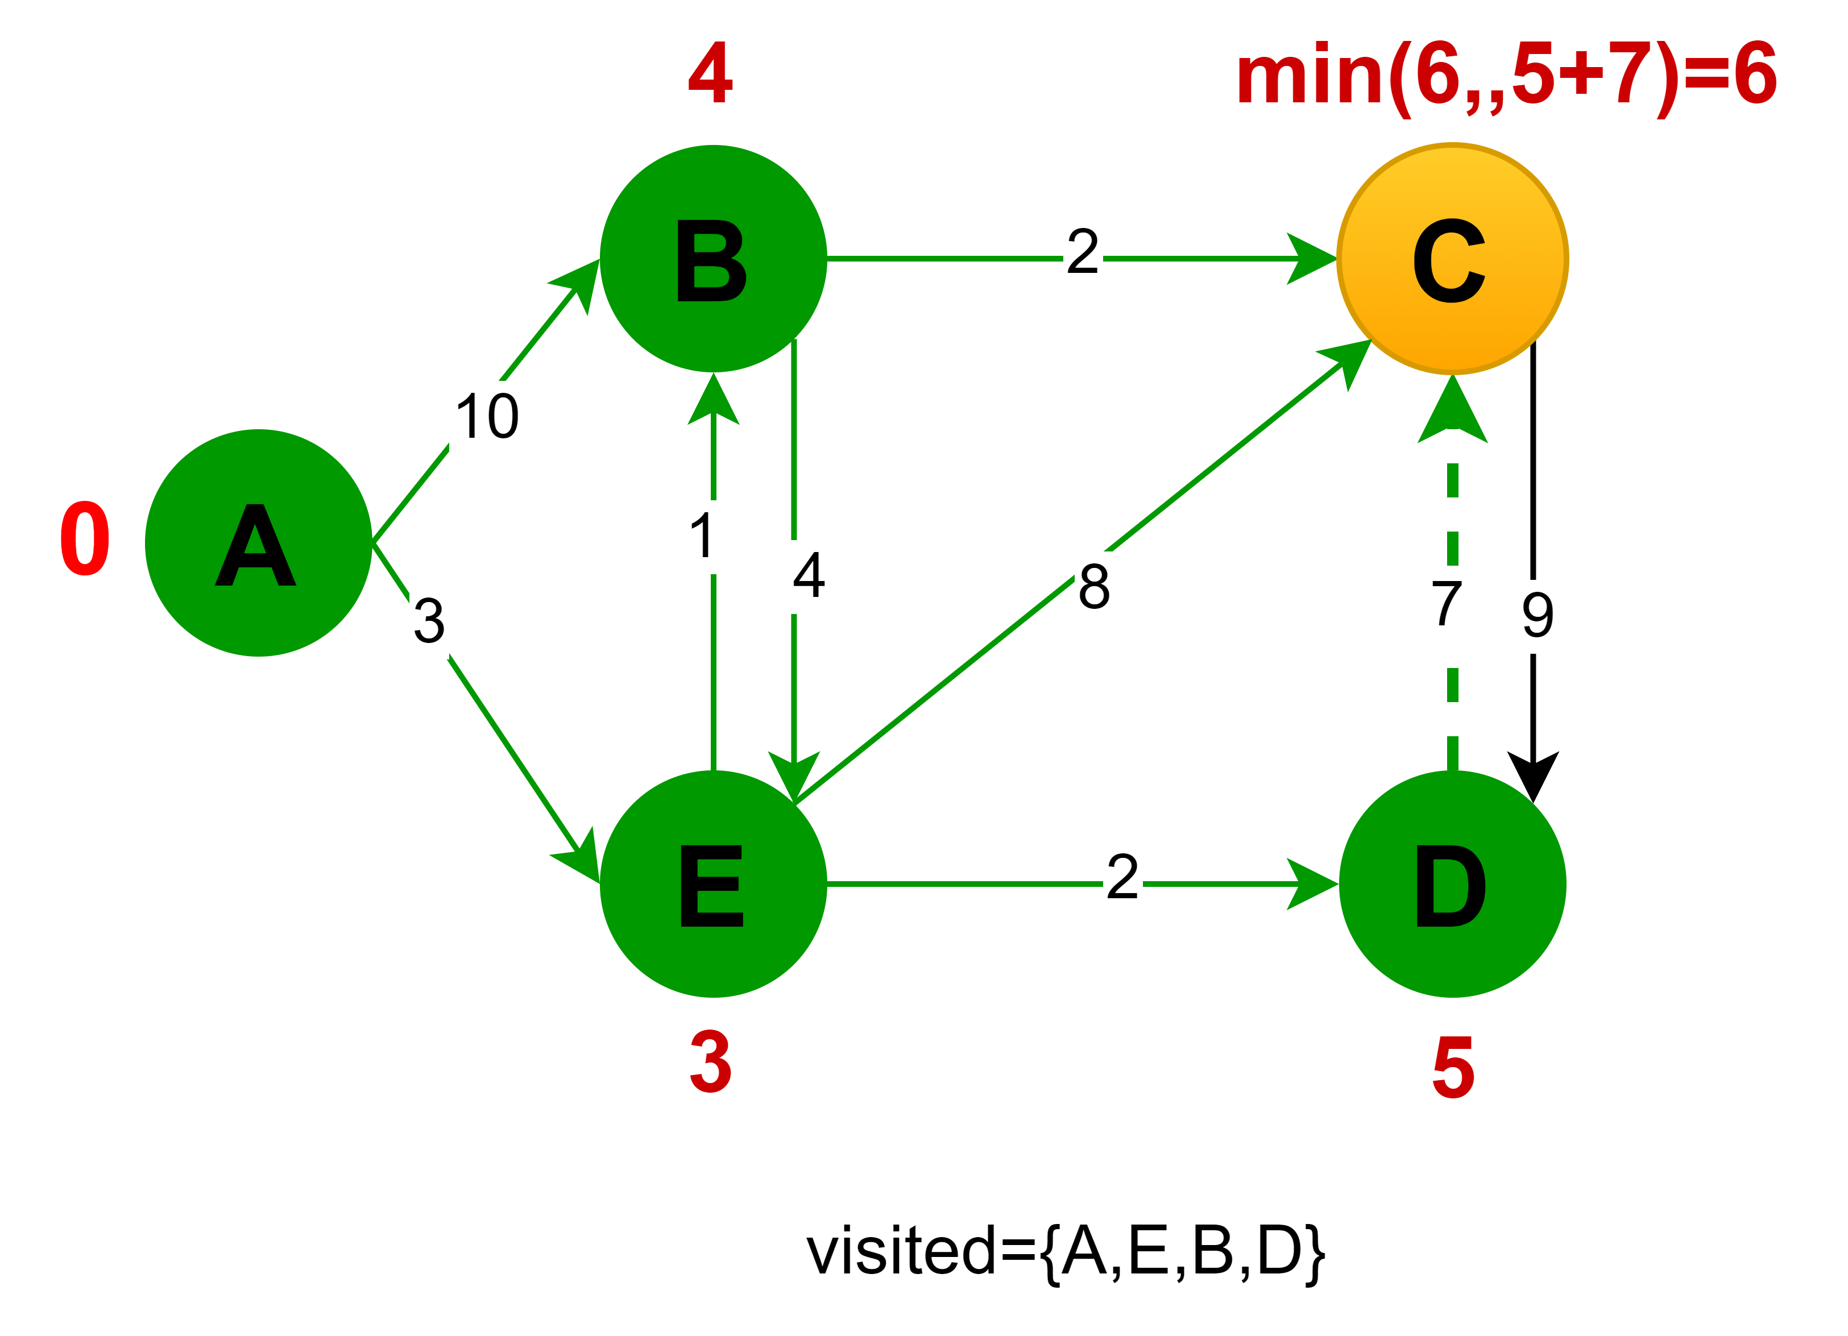
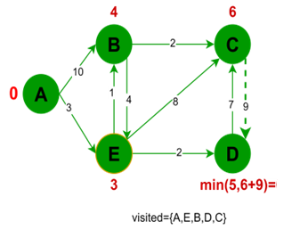
Dijkstra: example Illustration
5

Slide 44





All pairs shortest paths
Floyd-Warshal Algorithm

Slide 45
All pairs shortest path algorithm
To find the shortest paths between every pair of nodes in a weighted graph.
Applications:
  Network Routing: Used in network design and analysis to determine the most efficient routes between all pairs of nodes in a communication network.
  Urban Planning: Helps in planning the shortest paths between various locations in a city, useful for logistics and transportation planning.
  Social Network Analysis: Can be used to calculate the closeness between all pairs of individuals in a social network.
  Game Development: Used to calculate distances between all pairs of locations in game maps, essential for AI pathfinding.
  Bioinformatics: Useful in analyzing protein interaction networks or metabolic networks to understand the shortest pathways between different biological entities.

Slide 46
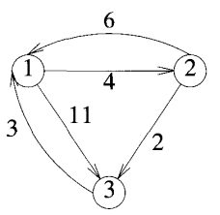

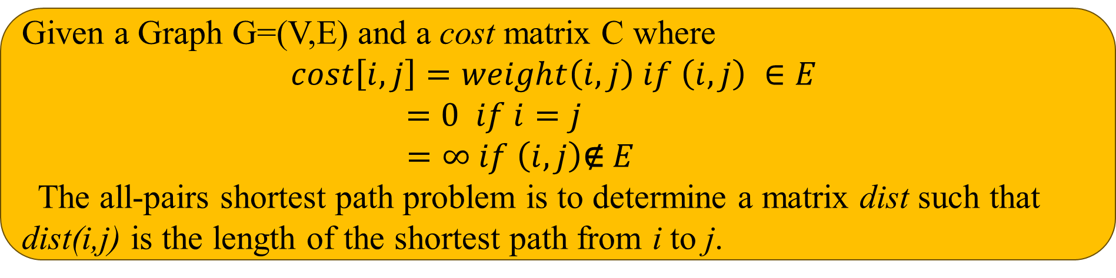

Problem description
Given a Graph G=(V,E) and a cost matrix C where
$$cost\left[i,j\right]=weight\left(i,j\right) if \left(i,j\right) ∈E$$
$$=0 if i=j$$
$$=∞ if \left(i,j\right)\text{∉} E$$
The all-pairs shortest path problem is to determine a matrix dist such that dist(i,j) is the length of the shortest path from i to j.
Input
Graph Cost matrix
Output
Distance Matrix
$\left[\begin{matrix}0 & 4 & 11 \\ 6 & 0 & 2 \\ 3 & ∞ & 0\end{matrix}\right]$
$$\left[\begin{matrix}0 & 4 & 6 \\ 6 & 0 & 2 \\ 3 & 7 & 0\end{matrix}\right]$$

Slide 47
Algorithm: Floyd Warshal
Algorithm Floyd_Warshal(G, cost)
Input: Graph G =(V,E), cost matrix and source vertex v.
Output: A matrix dist of size nXn where dist[i,j]=shortest path distance of j from i.
Method:
for i = 0 to n-1
for j = 0 to n-1
dist[i,j]=cost[i,j]
for k from 0 to n-1
for i from 0 to n-1
for j from 0 to n-1
if dist[i,k] + dist[k,j] < dist[i,j] then
dist[i,j] = dist[i,k] + dist[k,j]
end if

Slide 48
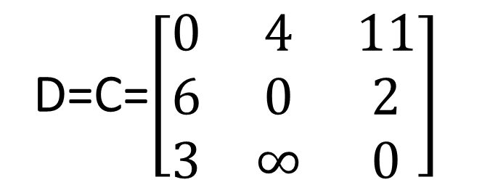
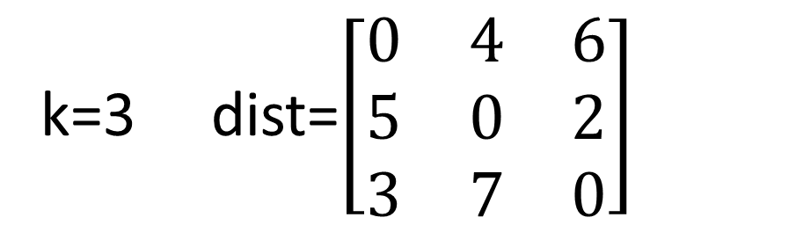
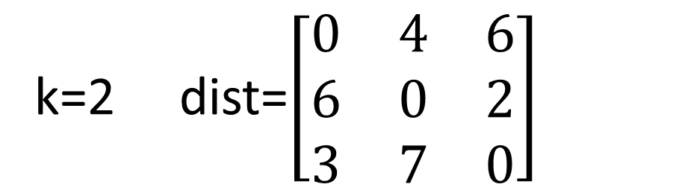
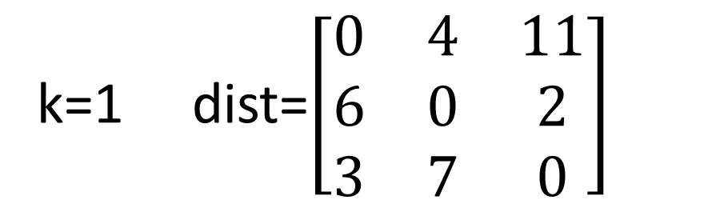
Floyd Warshal: example Illustration
Algorithm’s Tracing
Given
k=1 dist=$\left[\begin{matrix}0 & 4 & 11 \\ 6 & 0 & 2 \\ 3 & 7 & 0\end{matrix}\right]$
k=2 dist=$\left[\begin{matrix}0 & 4 & 6 \\ 6 & 0 & 2 \\ 3 & 7 & 0\end{matrix}\right]$
D=C=$\left[\begin{matrix}0 & 4 & 11 \\ 6 & 0 & 2 \\ 3 & ∞ & 0\end{matrix}\right]$
k=3 dist=$\left[\begin{matrix}0 & 4 & 6 \\ 5 & 0 & 2 \\ 3 & 7 & 0\end{matrix}\right]$
Final Distance Matrix

Slide 49
Minimum Spanning Tree (MST)

Slide 50



Spanning Tree
A spanning tree of a connected graph is the subgraph that includes every vertex of a given graph, without cycles.
A graph may have many spanning trees
The cost of a spanning tree is the sum of all the edge weights
A minimum spanning tree (MST - there may be many) is the spanning tree with the minimum cost.
Graph
1
A
1
B
A
B
A
B
6
6
2
2
2
C
5
C
C
3
4
1
4
1
1
D
E
D
E
D
E
2
2
Spanning Tree 2
Cost = 6
(MST)
Spanning Tree 1
Cost = 13

Slide 51
Algorithm: kruskal
Algorithm Kruskal(G, cost)
Input: Graph G =(V,E), and cost of each edge.
Output: Tree: Minimum Spanning Tree of G
Method:
Tree= φ
E’=Set of all edges in increasing order of their costs
while Tree has less than n-1 edges and E’ ≠ φ
Choose next edge (u,v) from E’
Delete (u,v) from E’
if (u,v) doesn’t create cycle in Tree then
add (u,v) to Tree
return Tree

Slide 52
Kruskal’s Algorithm
1
A
B
6
E’={(A,B):1, (C,E):1, (A,C):2, (D,E):2, (A,D):3, (C,D):4, (B,E):5, (B,C):6}
2
3
C
5
4
1
D
E
2
Step 1: Choose (A,B)
Step 2: Choose (C,E)
Step 3: Choose (A,C)
Step 3: Choose (D,E)
1
1
1
1
A
B
A
B
A
B
A
B
2
2
C
C
C
C
1
1
1
D
E
D
E
D
E
D
E
2

Slide 53
Thank
You

